Slide 1
Starting on ‘Microsoft Teams’
Maxine Newboult
June 2020

Slide 2
Getting Started
Microsoft Teams is the program we are going to be using in school for online communication between teachers and pupils.
You can access it in 3 ways:
Download the Microsoft Teams app to you phone
Log in through the website - https://teams.microsoft.com/start
Download the program to your device/laptop - https://teams.microsoft.com/downloads
You can pick one of the above, or use a combination.
Then use your pupil email and password to log in (these will be sent out to you separately).

Slide 3
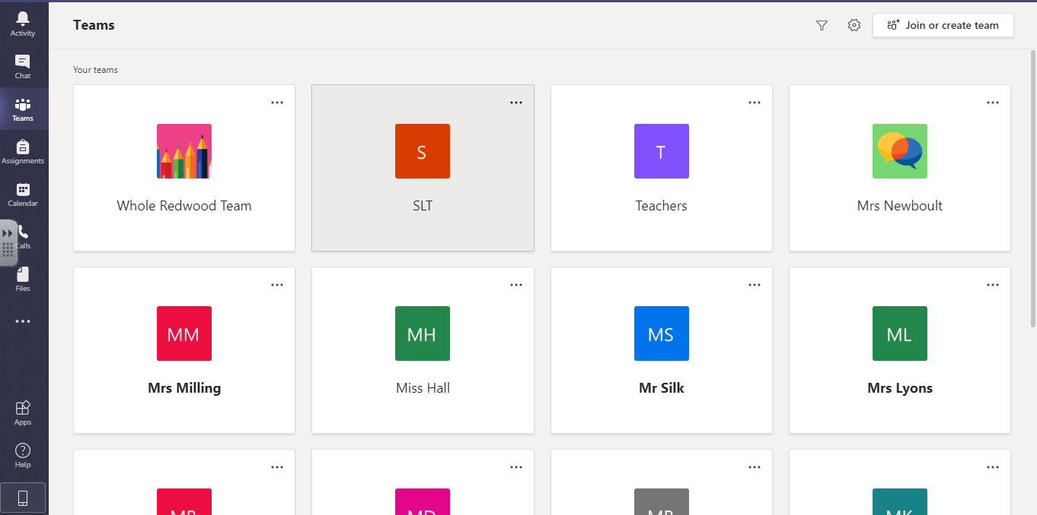
Opening up Teams
Main navigation is via the tabs in this column and then tabs are above in each teams area.

Slide 4
Class Teams
‘Teams’ shows you the groups that you are a part of.
You will not have this many teams on your screen. We have made teams for your class groups; you will only see your own class group.

Slide 5
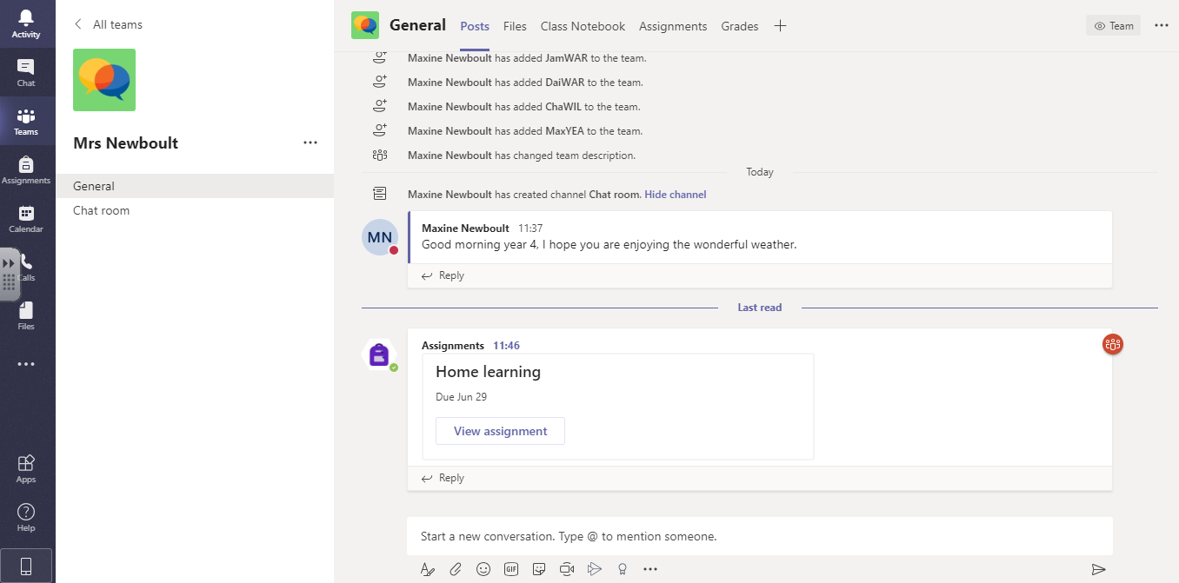
Access to you class information
Clicking on your teacher name and ‘Team’ will take you to your class page. It will look similar to this page.
The ‘General’ section is where we can tell your class about general news and let pupils know what work needs to be sent in.
You are all able to write any questions or queries about your work and other pupils will be able to see and reply to your comments.
This discussion will help you, just like a talking partner in class!

Slide 6
How to write a message
When you see a comment has been sent and you want to reply, simply click on reply and then write your response to this question or comment.
To talk about something new, write here. You can include @name if the response is for someone directly.

Slide 7
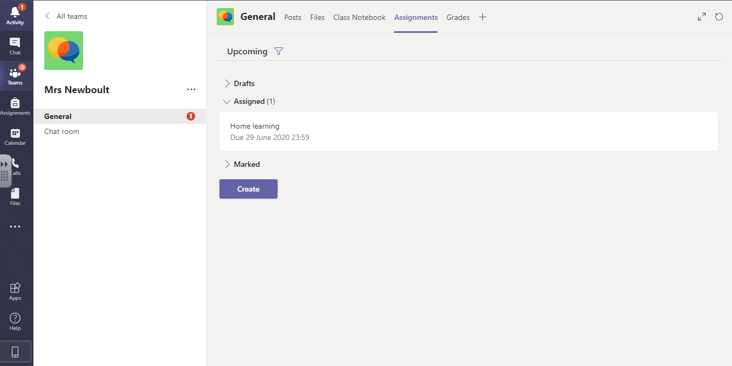
Notifications
‘Activity’ shows you that you have something new to respond to or read.
This number shows you if you have any assignments or someone has mentioned you in a comment. (by using @yourname).

Slide 8
Assignments
At the top there are new tabs for you to use.
Your ‘Assignments’ can be found here and they will also show you the date that your work is due into the class teacher.
Have a look and explore each of the tabs to familiarise yourself.

Slide 9
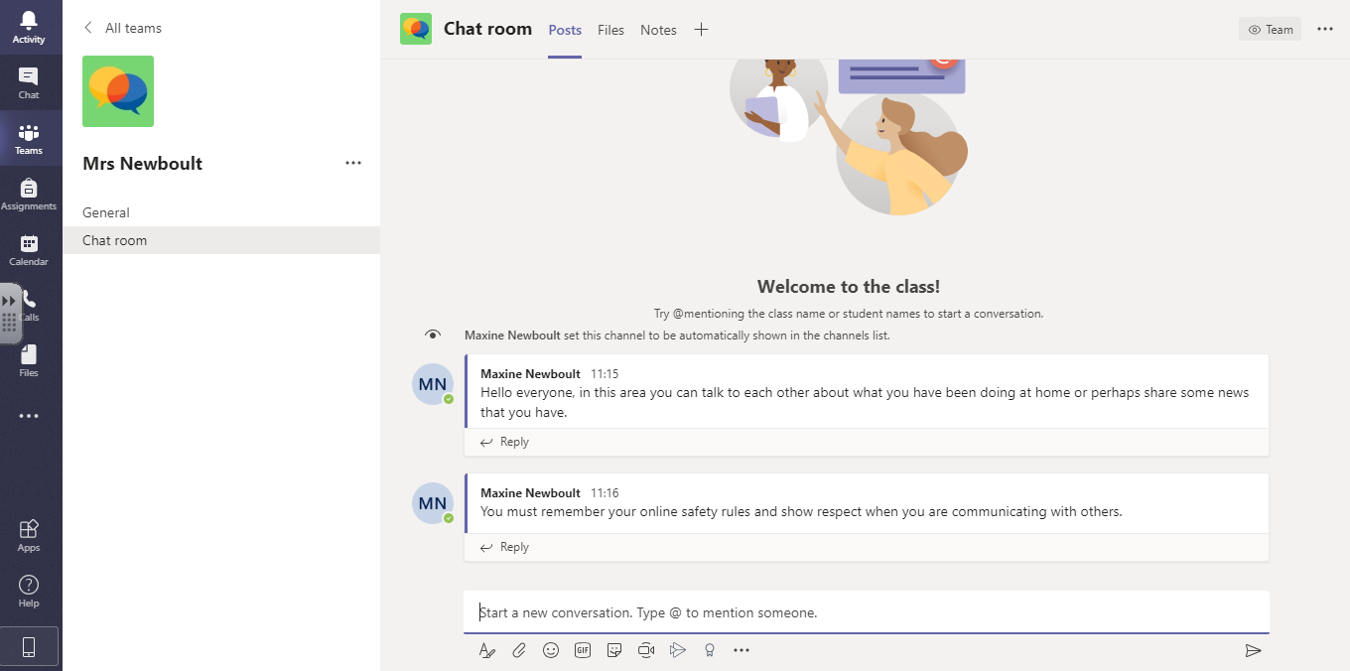
‘The Chat Room’ is your casual group chat space.
You can use this area like a virtual playground. You can talk about anything you like within your class group, whether it is school related or not but remember to be respectful in your discussions.
Add anything here you think the others might like to hear about.
Your teacher will be monitoring this area so do not write anything you would not say to your teacher or other pupils within the classroom.
‘The Chat Room’

Slide 10
‘The Chat Room’
The teachers are looking forward to talking with you all in your new TEAM classes!
Remember to follow the online rules about communication – be kind and only write something that you would say to someone in person.

